Slide 1
Helical-Shaped Tungsten Oxide as Active Layer for Resistive Random-Access Memory Applications
John F. Hardy II*, Dr. Ying-Chen Chen
BS Student, Department of Electrical Engineering,
Northern Arizona University (NAU), Flagstaff, AZ, USA

Slide 2

Outline
Introduction
Results and Discussion
  Nanostructure of Helical Memory and Selector
  Electrical Characterization
Conclusion

Slide 3
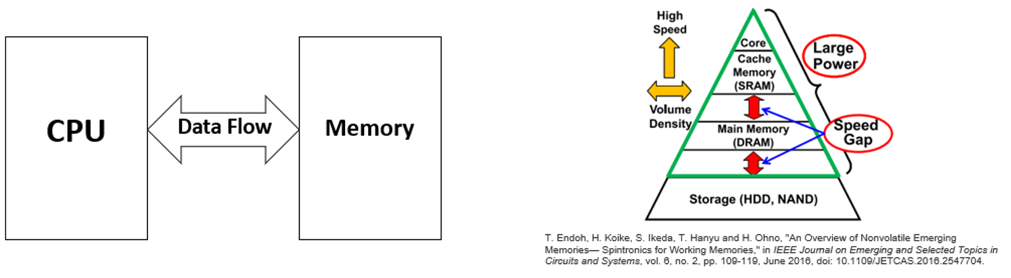
Von Neumann Bottleneck
To overcome the Von Neumann bottleneck, high-storage and high-performance memories are needed to fill the gap between computing and storage.
Notes:
In current computer technologies the Von Neuman architecture is commonly used.
In the architecture, the separation of the CPU and Memory requires high power when data is processed and increased latency in the system.

Slide 4
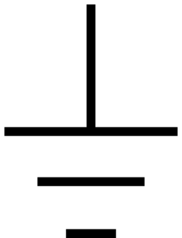
Current RRAM Architecture
+V
-V
Metal
Oxide
Metal
Resistive random-access memory (RRAM) is a proposed solution because of its high speed, high scalability, and low power applications.
Notes:
One proposed solution to the bottleneck is resistive random-access memory.
Common RRAM architectures consists of a TF metal top electrode and bottom electrode, with a TF oxide active layer.
When a positive bias is applied to the top electrode, a CF of oxygen vacancies are formed creating a LRS.
When a negative bias is applied to the TE, the CF is ruptured creating a HRS.

Slide 5
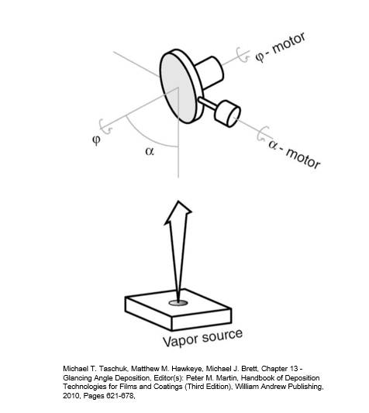
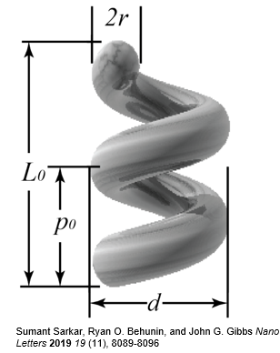
Helical Structures
(a)
(b)
(a) GLAD Fabrication (b) Helical Model
Utilizing the helical nanostructure for RRAM is designed for higher scalability, higher density, and improved device characteristics.
Notes:
My research proposes the utilization of helical nanoscructures in the oxide layer to
Improve the scalability, density, and device characteristics.
Glancing angle deposition is used for the process
d=diameter p=pitch (Once complete helical turn 50nm) l=length(oxide thickness) r=radius

Slide 6
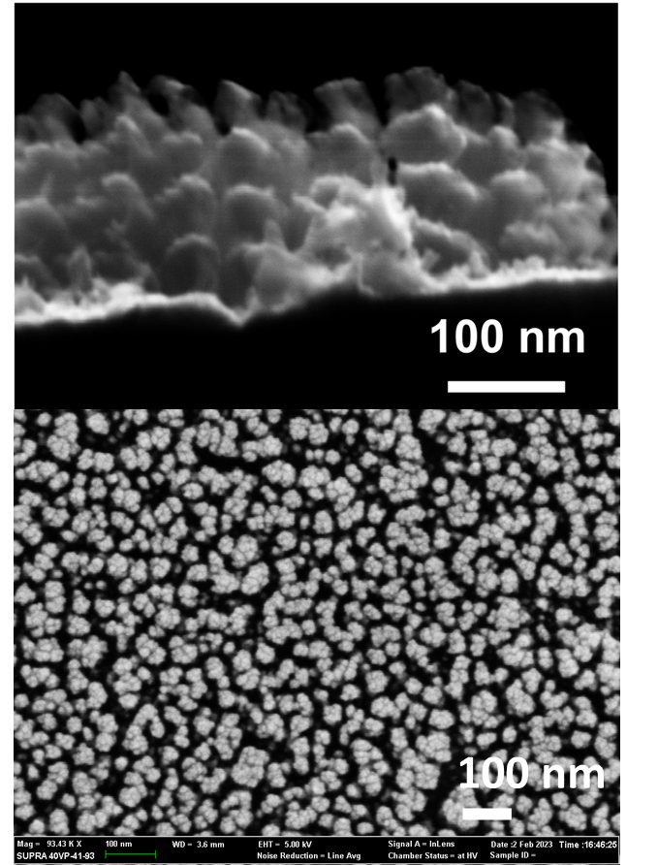
Fabrication Process and Nanostructures
(a)
(b)
(a) TF Fabrication (b) Helical Fabrication
Helical TEM Cross section
(b) Helical SEM Top View
Notes:
The devices used in this research uses Indium Tin Oxide (ITO) as a BE and TE with WOx as the active layer.
Devices with 50nm, 100nm, and 200nm thickness with diameters of 50um are created to be compared in this work.
To create the helical devices using ebeam PVD an ITO substrate is tilted to 86 degree and rotated at a rate which is proportional to the deposition rate of the WOx. A Layer of 150nm of ITO is then deposited with a shadowmask applied to pattern the edgeless RRAM devices.

Slide 7
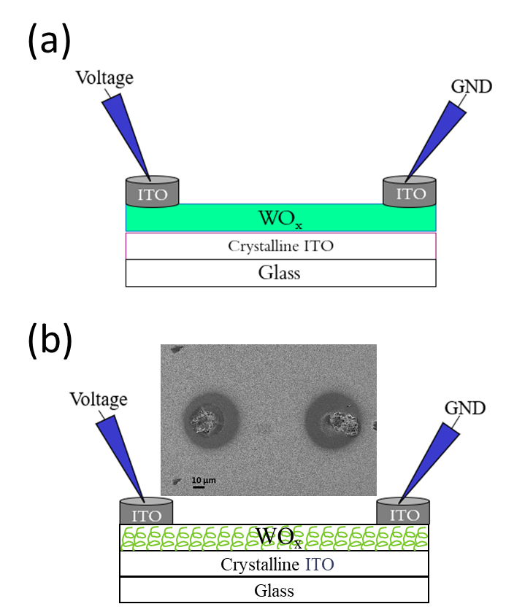
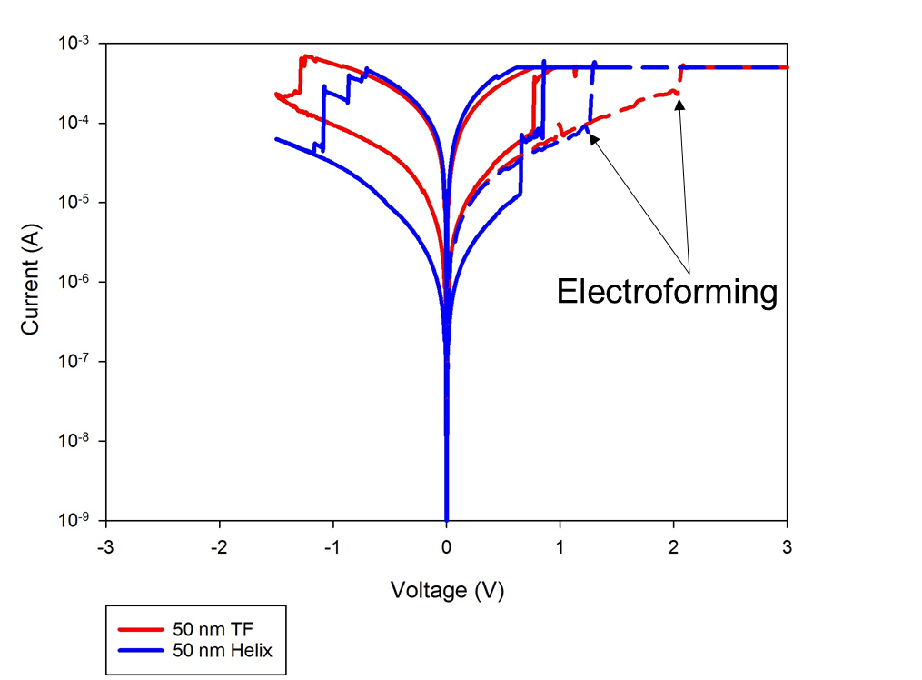
I-V Characteristics
Reset
Set
CCL= 500 µA
(a) TF Model (b) Helical Model
Electroforming voltage is reduced by using helical structure, while the memory window is enlarged.
Notes:
Explain IV curve
Helical and TF devices with CCL of 5mA and helical devices with 500uA are studied in this research.
Median Set/Reset data used in results. Electroforming voltage is reduced in helical structures with memory window enlargement.
TF/Helical 5mA Parameters Forming: 9V 5mA CCL Large Reset: -6V Set: 2V 5mA CCL Reset: -3V
Helical 500uA Parameters Forming: 9V 500uA CCL Large Reset: -10V 2nd Forming: 4V 500uA CCL
Set/Reset: 1.5V 500uA CCL and -1.5V

Slide 8
Switching Voltage and Current
Reset
Set
Set
Reset
The helical device operated at 500 µA has reduced the reset voltage by 61.5% and 71.2%, as compared to TF and helical devices operated at 5 mA.
Switching current is also reduced by 85.3% and 61.7%.
Notes:
Light blue plots= 500uA helical data
Dark blue plots= 5mA helical data
Red plots= 5mA TF data

Slide 9
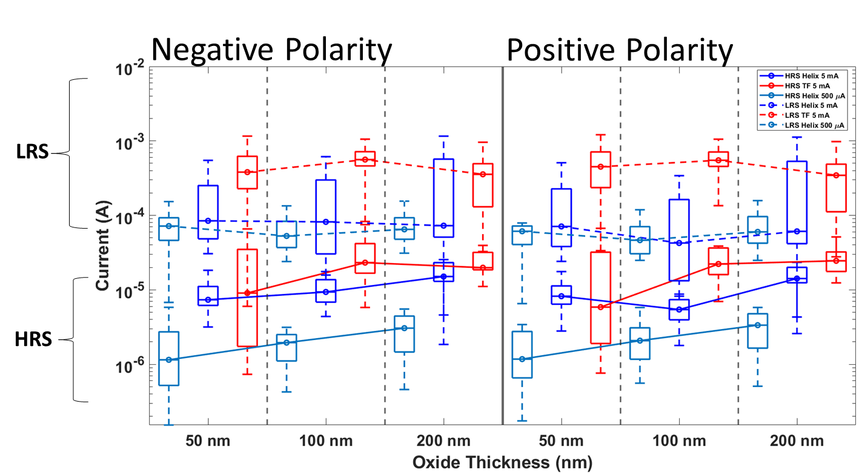
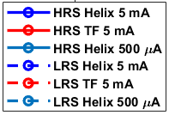
HRS and LRS for TF and Helix Devices
The memory state does not change with read polarity.
HRS current is reduced for helical devices operated at 500 µA.
Notes:
Helical HRS is reduced by about 84%
Question: Why are the HRS affected by Oxide Thickness??
Answer: The current theory is that as oxide thickness increases, so does the surface area in helical devices increasing the defects in the oxide. This is why 50nm is optimal case studied.

Slide 10
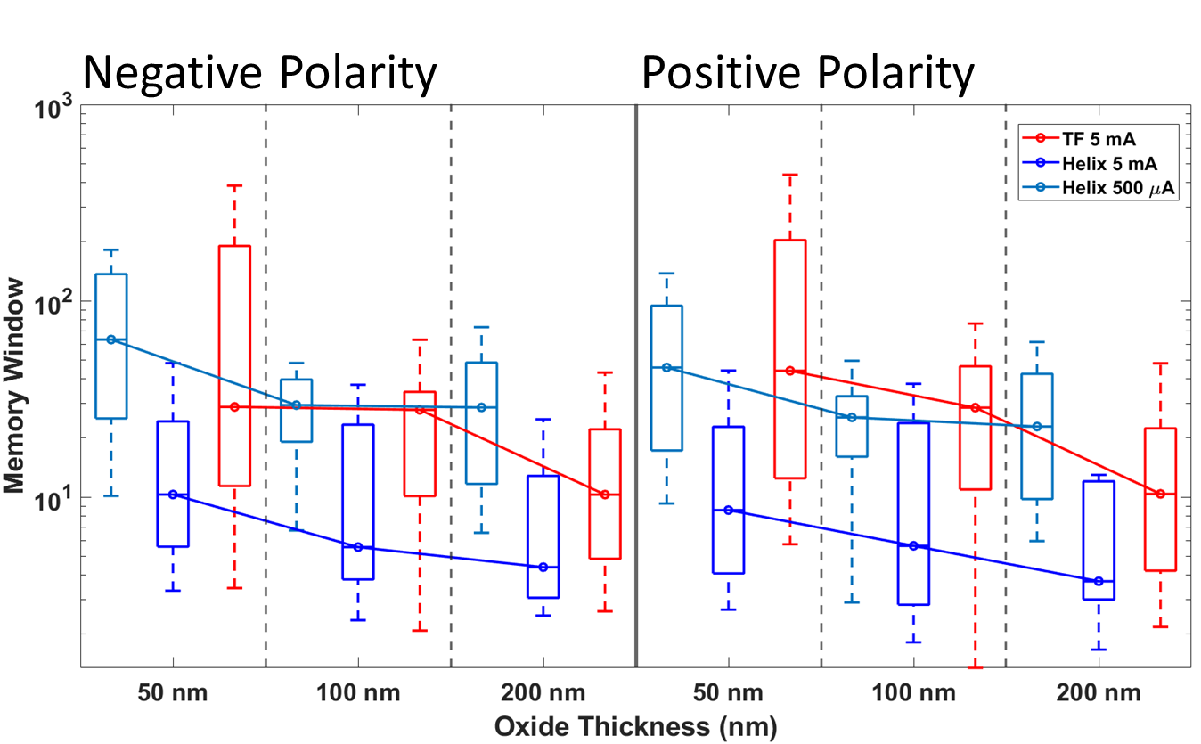
Memory Window
The memory window increased ~1 order with a CCL of 500 µA as compared to 5 mA .
The memory window increases as device is scaled.
Notes:
Why is memory window higher in 500uA devices?
Due to the increase of resistivity in the HRS for applying a larger reset, the memory window increases.

Slide 11
Switching Power Consumption
Reset
Set
The helical devices operated at 500 µA has reduced the reset power and set power by 95.4% and 85% as compared to TF devices.
Notes:
Low Power Consumption is important,

Slide 12
Memory Window vs. Power Consumption
Ideal
5 mA Helix/TF Set
5 mA Helix/TF Reset
500 µA Helix Set/Reset
Dash: Reset
Solid: Set
By changing CCL to 500 µA the helical device characteristics become closer to ideal.
Notes:
In memory, and ideal device will have a larger memory window with a low power.

Slide 13
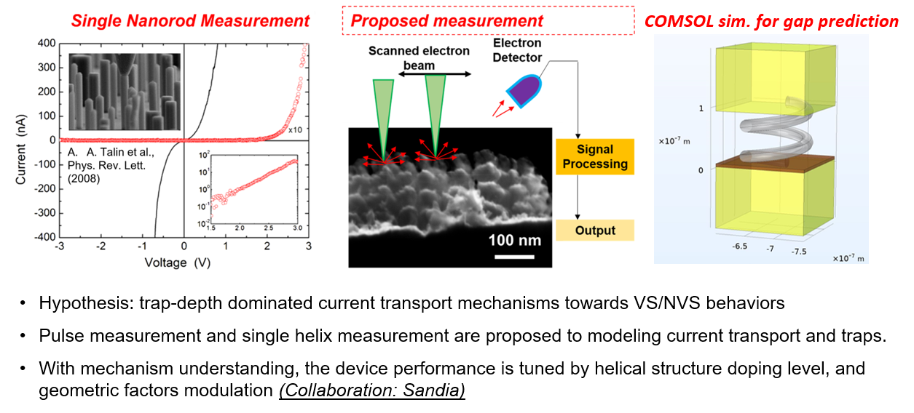
Future Work:
Notes:
Future work consists researching the current transport mechanisms of the helical devices.
The current hypothesis is that: trap-depth dominates the current transport mechanism towards VS/NVS behaviors.
Future work also consists of changing the gemetric characteristics of the helicies and using COMSOL to simulate
And better understand the current trapping behaviors.

Slide 14
Conclusion
Helical nanostructures have been presented as the active layer in RRAM applications.
The helical devices operated at 500 µA show a reduction in power consumption.
Memory window increases as helical devices are scaled from 200 nm to 50 nm.
Memory window increases by ~1 order as helical devices are operated at a 500 µA CCL.
The physical modeling and COMSOL simulation are included in the future work.

Slide 15










Acknowledgements
SiO_{x} RRAM
University College London
Prof. Adnan Mehonic
Neuromorphic Computing
Univ. of Toronto,
Prof. Amirali Amirsoleimani
University of Michigan
Prof. Yiyang Li
Radiation Effect
KU Leuven
Prof. Jeffery Prinzie
National Yang Ming Chiao Tung Univ. (Prior NCTU), Hsinchu, Taiwan
Radiation
Prof. King Chung
RRAM and FeRAM
Prof. Tuo-Hung Hou
Director, TSRI
Sandia National Laboratory
Electronics and Emerging Computing and circuit
UT Austin
Prof. Jack Lee
Prof. Deji Akiwande
Prof. Earl Swartzlander
Prof. Sanjay Banerjee
NVM and Process
Associate Researcher, TSRI, Taiwan
Dr. Steven Lin
Spiral Materials and analysis
NAU, Prof. John Gibbs
NAU, Prof. Mark Loeffler
Synapse-mimic circuit design
and neural simulating system
James Cook University, Australia,
Prof. Mostafa Rahimi
SDRL team
15
2023 Arizona Space Grant Student Research Symposium│ April 21-22, 2023
15
Notes:
I would like to thank and acknowledge those who have supported this research

Slide 16


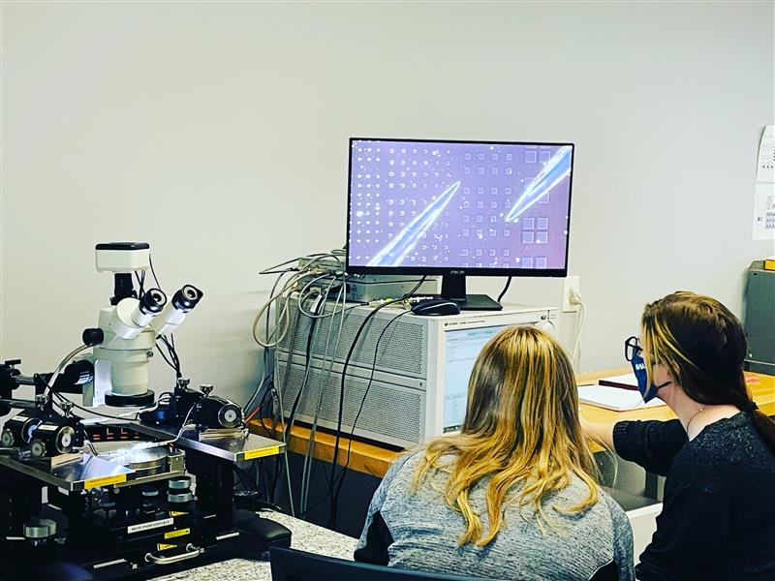




Thank you!
Collaborators and Sponsors:
Notes:
Thank you for your time.

Slide 17
Backup Slides

Slide 18
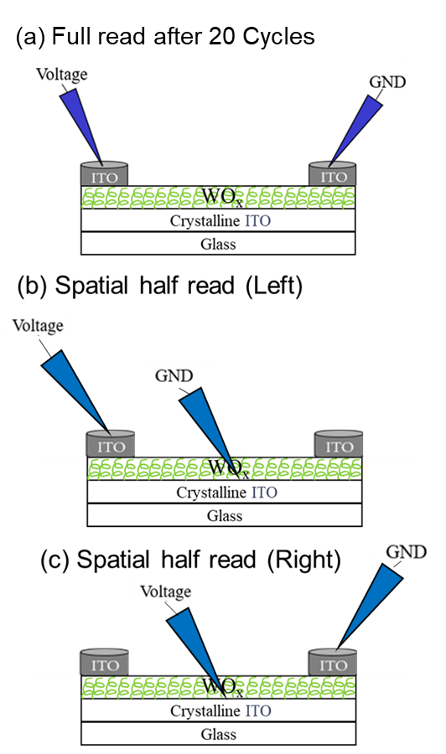
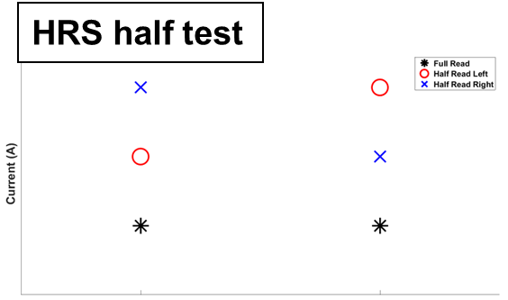
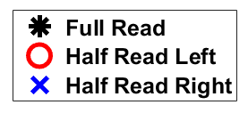
Physical Modeling- Spatial Half-Test-Half-Read (SHTHR) Method
Switching Gap Left
Switching Gap Right
HRS | CF Left | CF Right
50 nm | 45% | 35%
Conductive filament is suggested to form in the anode side (+V) based on the SHTHR method.
Notes:
In our research it is also theorized that the conductive filament in planar devices travel from the TE to the BE
By going into the oxide, through the floating bottom, and back into the oxide.
Where the CF ruptures is tested through the Spatial Half-Test-Half-Read Method.
From the testing of 20 devices, it is suggested that the conductive filament’s switching gap occurs on the anode side in 50nm devices

Slide 19
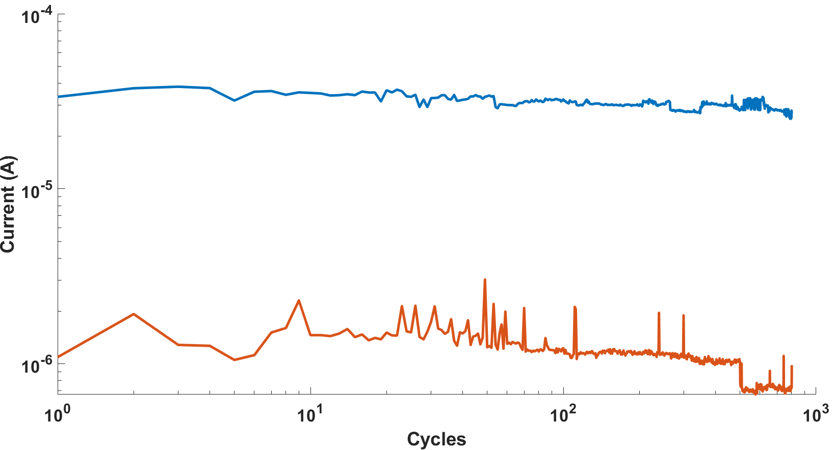
Reliability Charateristics
100 nm Endurance
Retention
100nm
Notes:
SiOx 200 nm
3 masks (BE, SiOx, TE)
BE: 165 nm, SiOx 200 nm, TE 100 nm

Slide 20
Why Tungsten-Oxide?
WOx is CMOS compatible with W commonly used in low metal layer (M0), and WOx used in transistor oxide for its high K properties.

Slide 21
Physical Modeling- Spatial Half-Test-Half-Read Method
FR= Full Read
HRL= Half read left
HRR= Half read right
* Conditions in Current
HRS | CF Left | CF Right | Invalid
50 nm | 45% | 35% | 20%
100 nm | 35% | 25% | 40%
200 nm | 40% | 15% | 45%
HRS Conclusions:
Invalid if FR>(HRL|HRR)
CF Left if HRL<HRR
CF Right if HRR<HRL
LRS | CF Left | CF Right | Invalid
50 nm | 45% | 20% | 35%
100 nm | 20% | 45% | 35%
200 nm | 20% | 25% | 55%
LRS Conclusions:
Invalid if FR<(HRL|HRR)
CF Left if HRL<HRR
CF Right if HRR<HRL
Notes:
SiOx 200 nm
3 masks (BE, SiOx, TE)
BE: 165 nm, SiOx 200 nm, TE 100 nm

Slide 22
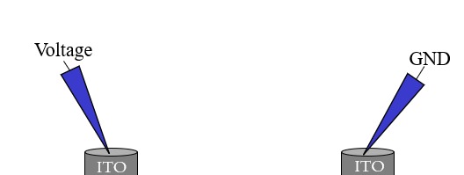
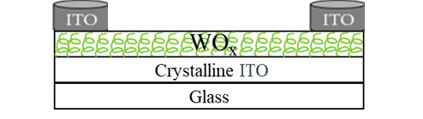
Backup Slides
WO_{x}
Crystalline ITO
Glass

Slide 23

Physical Modeling- Spatial Half-Test-Half-Read Method
HRS | CF Left | CF Right | Invalid
50 nm | 45% | 35% | 20%
100 nm | 35% | 25% | 40%
200 nm | 40% | 15% | 45%
HRS
CF on Left
CF on Right
LRS | CF Left | CF Right | Invalid
50 nm | 45% | 20% | 35%
100 nm | 20% | 45% | 35%
200 nm | 20% | 25% | 55%
LRS
Notes:
SiOx 200 nm
3 masks (BE, SiOx, TE)
BE: 165 nm, SiOx 200 nm, TE 100 nm

Slide 24
Physical Modeling- Spatial Half-Test-Half-Read (SHTHR) Method
HRS half test
LRS half test
CF on Left
CF on Right
CF on Left
CF on Right
HRS | CF Left | CF Right
50 nm | 45% | 35%
LRS | CF Left | CF Right
50 nm | 45% | 20%
Conductive filament is suggested to form in the anode side (+V) based on the SHTHR method.
Notes:
In our research it is also theorized that the conductive filament in planar devices travel from the TE to the BE
By going into the oxide, through the floating bottom, and back into the oxide.
Where the CF ruptures is tested through the Spatial Half-Test-Half-Read Method.
From the testing of 20 devices, it is suggested that the conductive filament’s switching gap occurs on the anode side in 50nm devices

